Slide 1
HF Ham Radio
Dr. Nathaniel Frissell, W2NAF

Slide 2
Questions!
How far can radio waves travel?

Slide 3
Questions!
What path do radio waves travel to get from one place to another?

Slide 4
Basic Modes of Propagation
Line-of-Sight (VHF+, > 30 MHz)
Ground Wave (MF and Below, < 3 MHz)
Sky-wave/Skip (HF, 3-30 MHz)

Slide 5
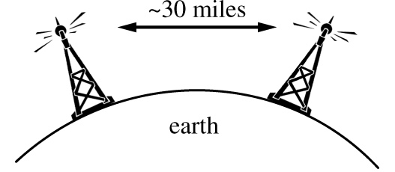
1. Line-of-Sight Propagation
Signals travel in straight line
Propagation Limited by Curve of the Earth
Very High Frequency (VHF) and above (> 30 MHz)

Slide 6
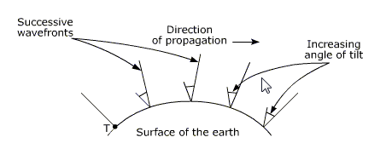
2. Ground Wave Propagation
Signals follow path of the ground
Farther than line-of-sight, shorter than skywave
MF (Medium Frequency) and below (< 3 MHz)
Occurs because currents are induced in the surface of the earth and this action slows down the wave-front in this region, causing the wave-front of the radio communications signal to tilt downwards towards the Earth.

Slide 7
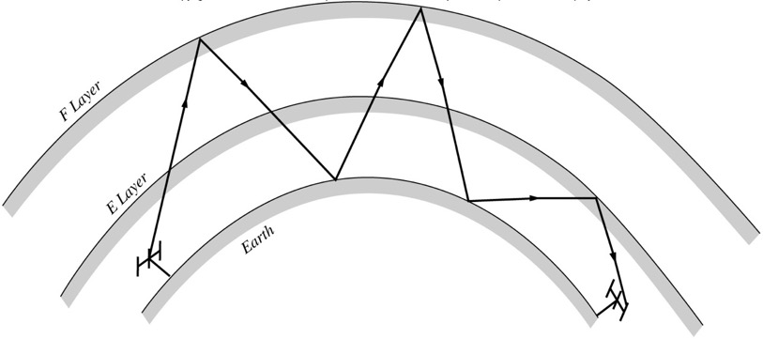
3. Skywave Propagation
Signals refract off the ionosphere
Travel Long Distances
HF (High Frequency, 3-30 MHz)
Highly dependent on Space Weather!

Slide 8
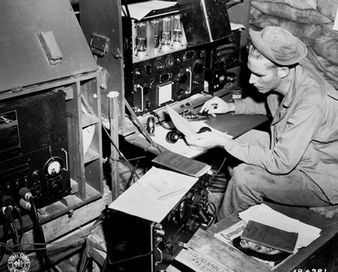
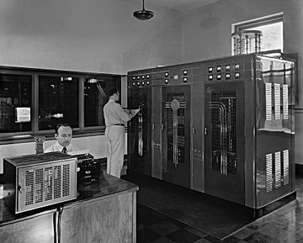
What is shortwave / HF radio?
Radio signals between 3 – 30 MHz that can travel around the world.
https://en.wikipedia.org/wiki/Wireless_telegraphy#/media/File:SCR188.jpg
This 10kW transmitter, installed in 1937 by CBS at its shortwave station W2XE in Wayne, N.J., was used to broadcast to South America. (Source: radioworld.com)

Slide 9
Shortwave is still used today!
Emergency Communications
Military
Commercial Airliners
Ships on the High Seas
Amateur (Ham) Radio Operators
Researchers

Slide 10
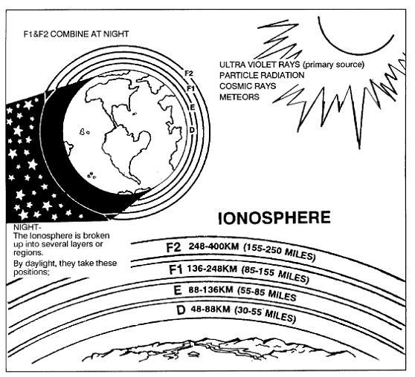
Ionosphere
Notes:
http://www.voxmaris.com.ar/images/en/ionosfera.jpg

Slide 11
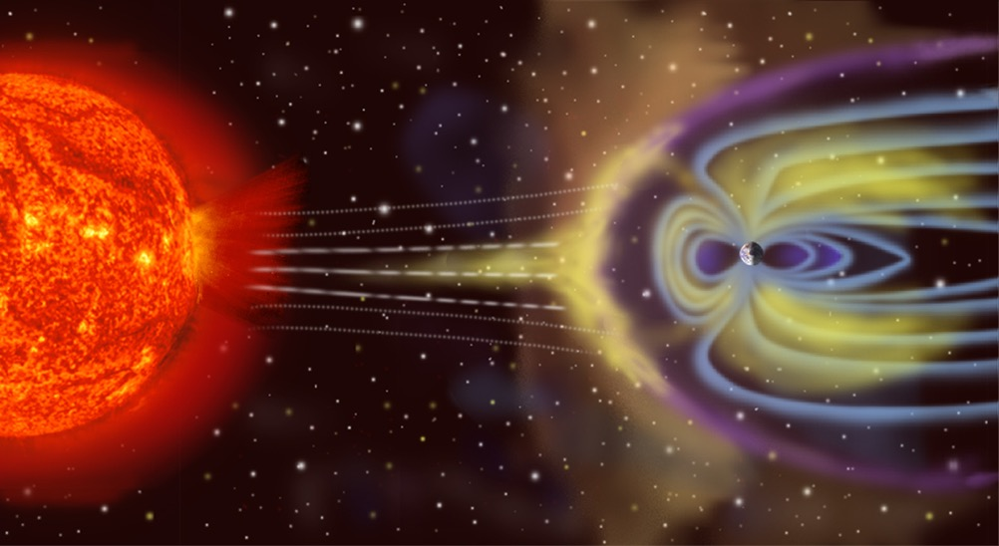
Space Weather
Image Credit: NASA

Slide 12
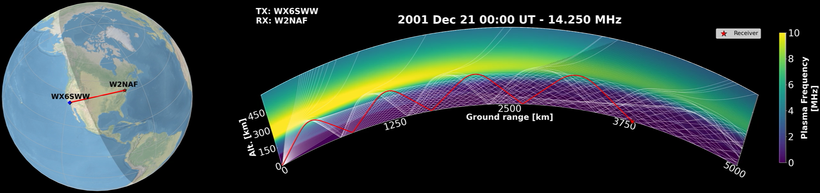
Skip Propagation

Slide 13
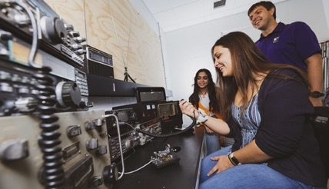
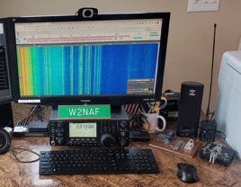
What is Amateur (Ham) Radio?
Hobby for Radio Enthusiasts
Communicators
Builders
Experimenters
Wide-reaching Demographic
All ages & walks of life
Over 760,000 US amateurs; ~3 million Worldwide
Licensed by the Federal Government
Basic RF electrical engineering knowledge
Each amateur radio station has a government-issued “call sign”
University of Scranton Students at W3USR
Photo by Byron Maldonado
W2NAF Home Station
Notes:
[http://www.arrl.org/arrl-fact-sheet]

Slide 14
Earning Your License
Three Levels of Ham Radio License:
Technician
General
Amateur Extra
Each license gives you progressively more frequency transmission privileges.
Each is a multiple choice exam from a public question pool.
Visit https://hamstudy.org/ for both practice and real exams!

Slide 15
Call Signs
Ham radio call signs generally have the following format:
W3USR
Prefix: Tells you the country and sometimes geography within the country
Ham radio ”countries” are actually DX Century Club or DXCC entities. You can see the current list here:
http://www.arrl.org/files/file/DXCC/2020%20Current_Deleted.txt
Suffix: Does not normally give any special information.
The easiest way to figure out the DXCC entity of a call sign is to search it on qrz.com.

Slide 16
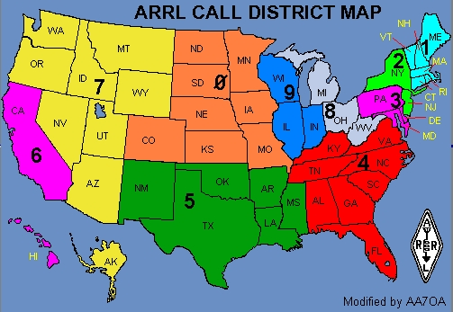
Call Sign Map

Slide 17
Some Country Call Sign Prefixes
Prefix | Country
K, W, N, AA-AK | United States
EI, EJ | Ireland
GM, GS, MM | Scotland
GW, GC, MW | Wales
G, GX, M | England
LA, LN | Norway
L, LU, LW | Argentina
LY | Lithuania
KL7 | Alaska
UR-UZ, EM, EO | Ukraine

Slide 18
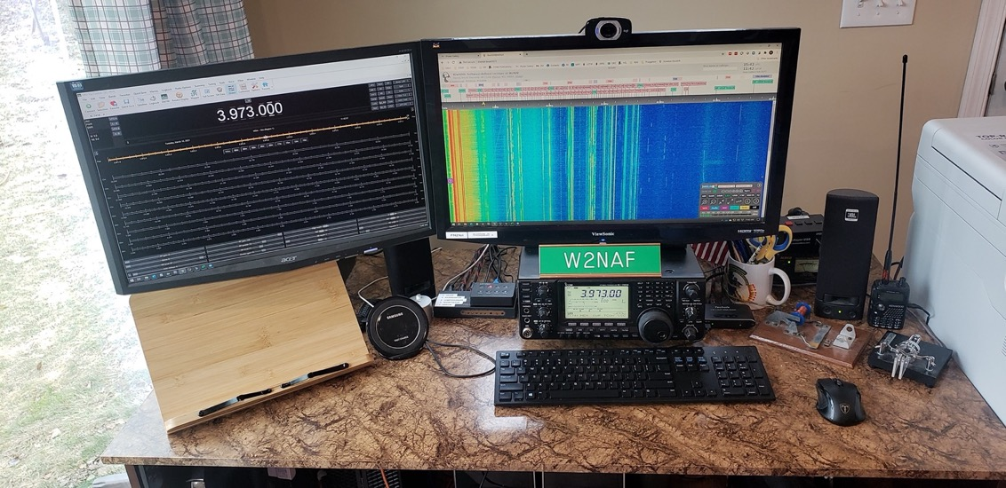
W2NAF Ham Radio Station

Slide 19
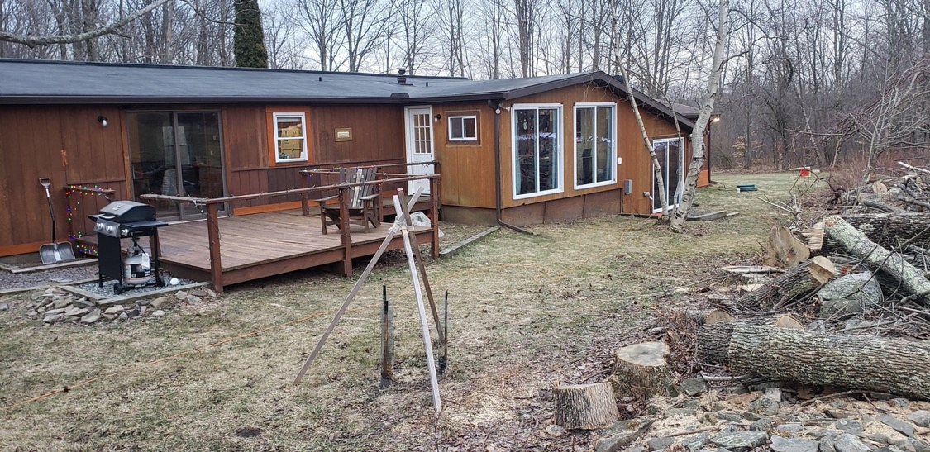
My House

Slide 20
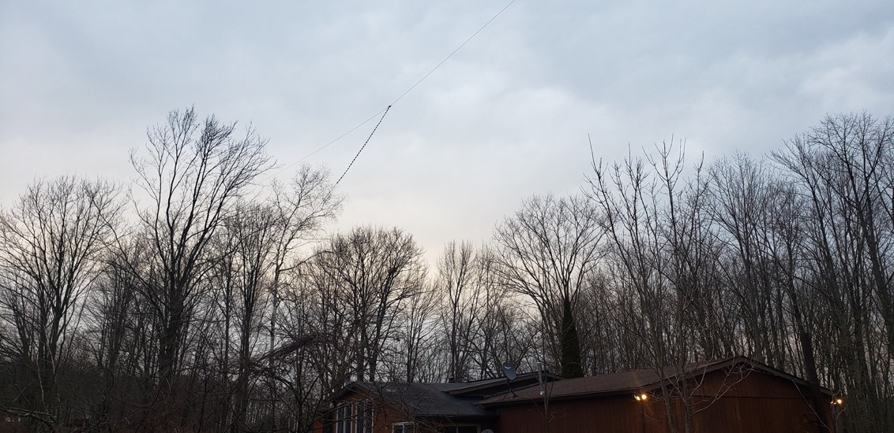
My Antenna

Slide 21
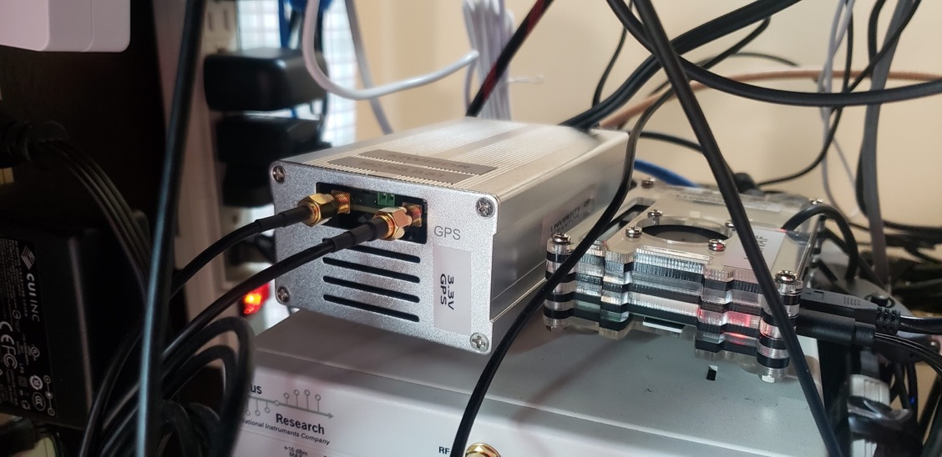
My KiwiSDR

Slide 22
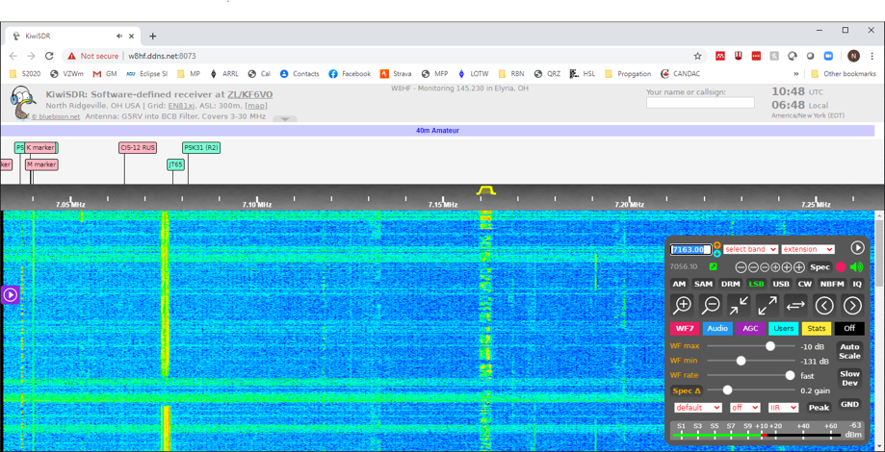
KiwiSDRs
If you don’t have your own radio at home, you can use a remote receiver over the internet. Visit http://kiwisdr.com/ and look for “listen live”.

Slide 23
Listening to Ham Radio on KiwiSDR

Slide 24
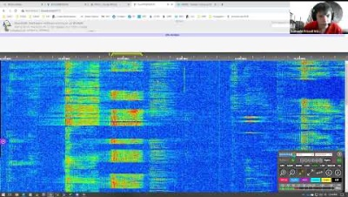

Slide 25
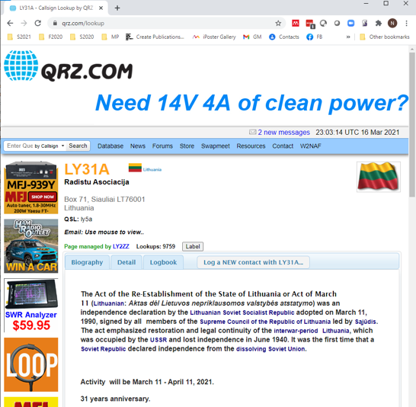
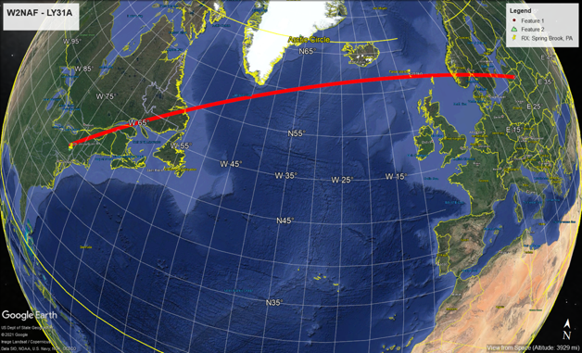
LY31A (Lithuania)
4200 miles (6800 km)

Slide 26
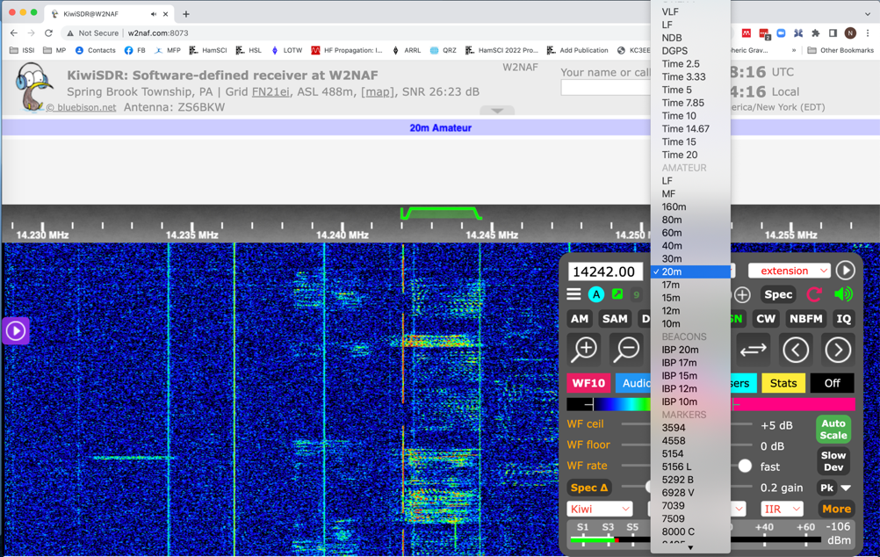
Ham Radio Band Selection
Choose an AMATEUR band
between 160 m and 10 m

Slide 27
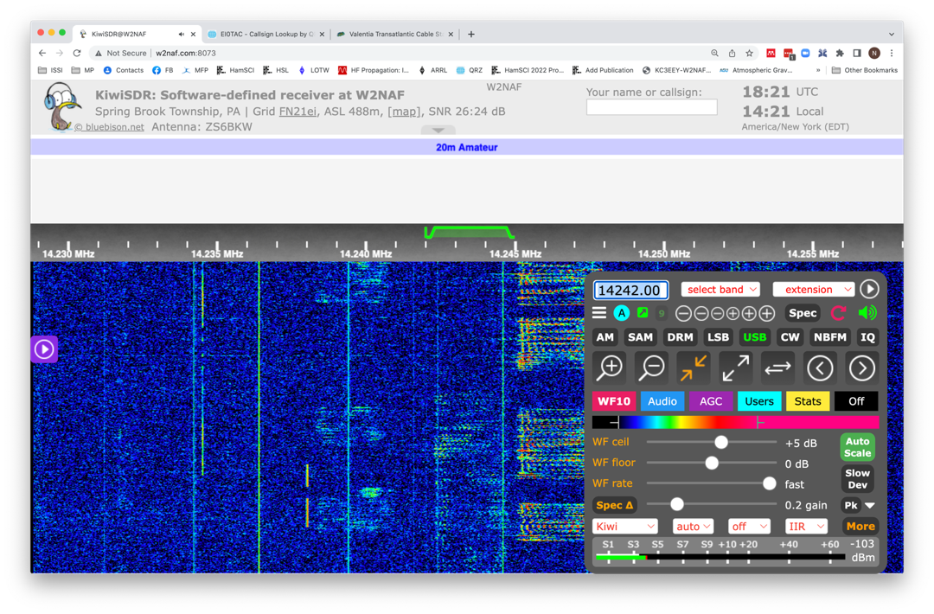
Mode Selection – Higher Bands
Choose “USB” (Upper Side Band) Mode for
frequencies GREATER than 10 MHz

Slide 28
USB Tuning
For USB, put the green marker to the LEFT of the signal.

Slide 29
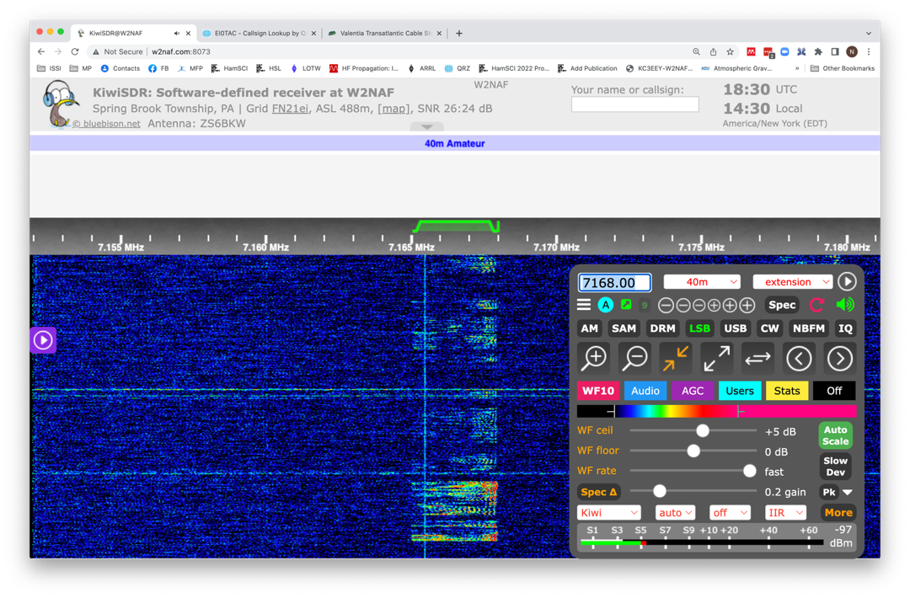
Mode Selection – Lower Bands
Choose “LSB” (Lower Side Band) Mode for
frequencies LESS than 10 MHz

Slide 30
LSB Tuning
For USB, put the green marker to the RIGHT of the signal.

Slide 31
Signal Reports – Ham Radio
HF ham radio operators use the “RST” System
Readability (R) | Signal Strength (S)
1. Unreadable | 1. Faint, signals barely perceptible
2. Barely readable, occasional words distinguishable | 2. Very weak signals
3. Readable with considerable difficulty | 3. Weak signals
4. Readable with practically no difficulty | 4. Fair signals
5. Perfectly readable | 5. Fairly good signals
 | 6. Good signals
 | 7. Moderately strong signals
 | 8. Strong signals
 | 9. Extremely strong signals
A perfect report is “59”.

Slide 32
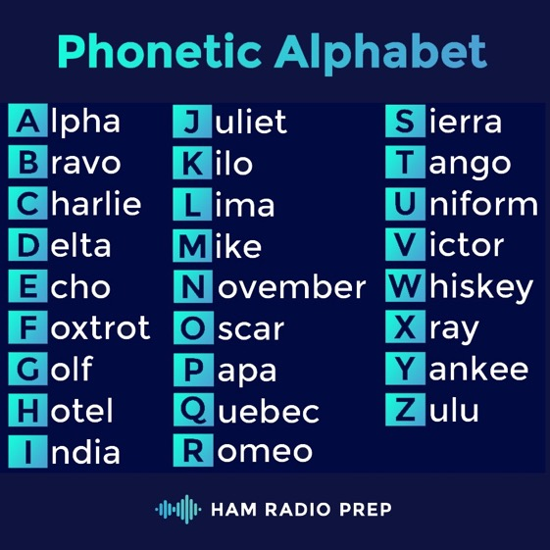
Phonetic Alphabet
https://hamradioprep.com/

Slide 33
Q-Signals & Ham Radio Codes
Code | Meaning
QSO | A radio contact
QTH | Location
QSL | I confirm.
QRZ? | Who is calling me?
QRT | I’m going off air.
QRP | Low Power
QSY | Changing Frequency
QLF | Please send with left foot
73 | Best Wishes
88 | Hugs & Kisses

Slide 34
Where to listen… Ham Radio
Band Name (Wavelength) | Phone Frequency Range [kHz] | Phone (Voice) Mode | “Best” Time
160 m | 1800 - 2000 | LSB | Night
80 m | 3600 - 4000 | LSB
40 m | 7125 - 7300 | LSB | Both
20 m | 14150 - 14350 | USB
17 m | 18110 - 18168 | USB | Day
15 m | 21000 - 21450 | USB
12 m | 24930 - 24990 | USB
10 m | 28300 - 29700 | USB
LSB = Lower Side Band
USB = Upper Side Band
Bandwidth: 3 kHz
Full list of ham radio frequencies available at
http://www.arrl.org/ graphical-frequency-allocations

Slide 35
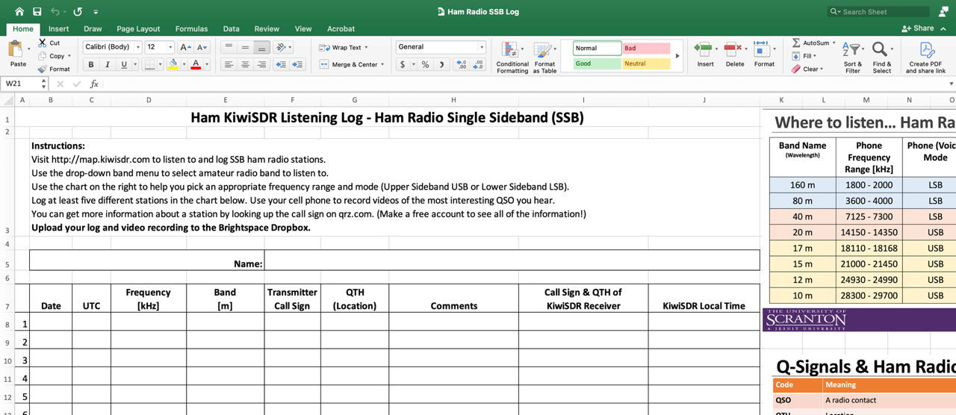
Listening Log

Slide 36
Coordinated Universal Time (UTC)
Ham radio operators, SWLers, and scientists use a single time zone.
Eastern Standard Time (EST) is 5 hours behind UTC.
UTC is always given in 24-hour format.
You may see it referred to by many names:
UT – Universal Time
UTC – Coordinated Universal Time
GMT – Greenwich Mean Time
Zulu (z)
Get current UTC time by listening to WWV/WWVH or from https://www.timeanddate.com/worldclock/timezone/utc

Slide 37
Space Weather, Solar Flares, and Shortwave Radio

Slide 38

The Geospace System
Atmosphere & Ionosphere
Sun
Magnetosphere
Solar Wind
Interplanetary Magnetic Field
Image Credit: NASA
NTS (Not to Scale!)

Slide 39
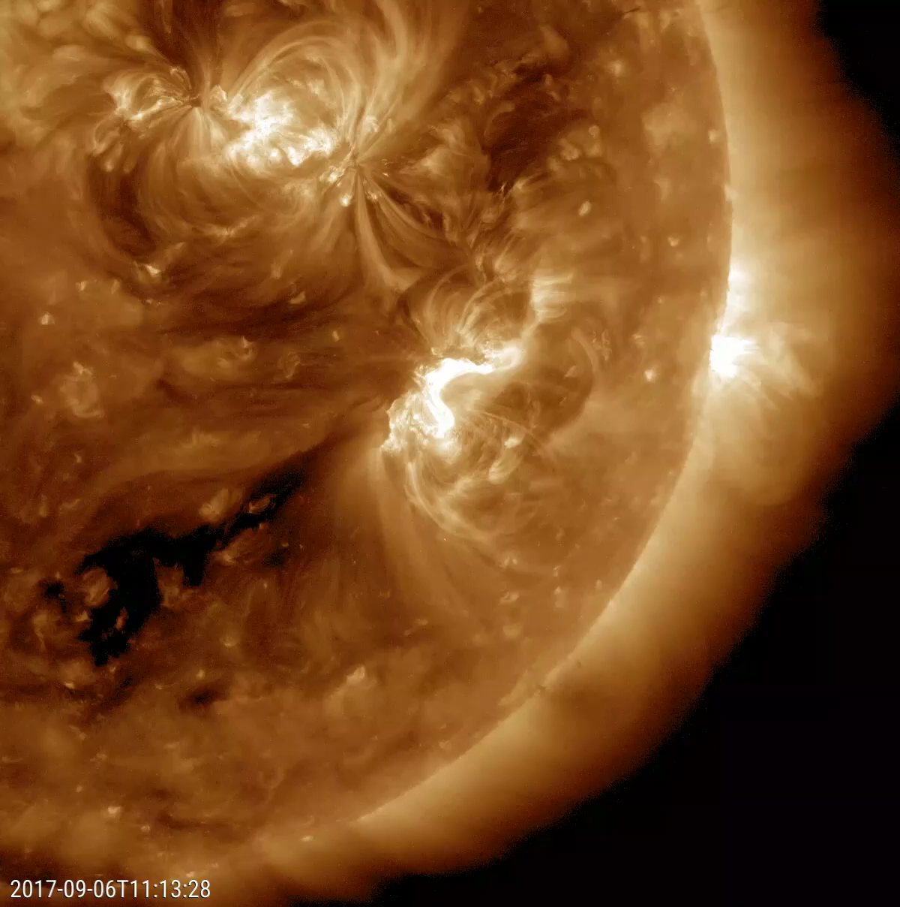
Solar Activity
Solar Activity: All of the violent and variable phenomena in the Sun’s atmosphere.
Solar activity follows a nominal 11-year/22-year cycle.
This is the main driver for all of the space weather we experience on Earth.
NASA SDO Observation of X9.3 Solar Flare on Sept 6, 2017

Slide 40
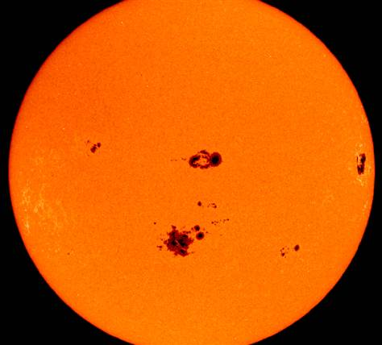
Sunspots
Sunspot: Small, darkened regions on the Sun with locally enhanced magnetic fields and relatively cool gas temperatures.
Sunspots typically have lifetimes of a few hours to a few months.
[NASA]

Slide 41
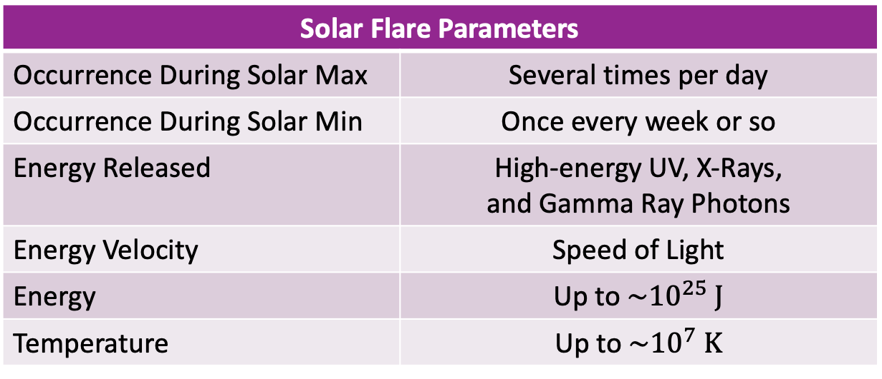
Solar Flares
Solar flare: Sudden increase in electromagnetic energy from localized regions on the Sun.
Energy travels at the speed of light (8 min to Earth)
Solar Flare Parameters
Occurrence During Solar Max | Several times per day
Occurrence During Solar Min | Once every week or so
Energy Released | High-energy UV, X-Rays, and Gamma Ray Photons
Energy Velocity | Speed of Light
Energy | Up to ${\sim 10}^{25} J$
Temperature | Up to ${\sim 10}^{7} K$
NASA SDO Observation of X9.3 Solar Flare on Sept 6, 2017

Slide 42
Solar Flares
Solar flares can cause disruptions to HF radio communications.
The soft X-Rays (0.1-0.8 nm) cause enhanced ionization of the D-region (lowest layer of ionosphere).
The D region ionosphere is known to absorb, not refract, HF radio waves. This is bad for communications!
NASA SDO Observation of X9.3 Solar Flare on Sept 6, 2017
Notes:
https://solarsystem.nasa.gov/resources/384/major-solar-flare/
Retrieved 12 Sept 2018
Photojournal: PIA21949
Source: NASA/GSFC/Solar Dynamics Observatory
Published: November 30, 2017
A large sunspot was the source of a powerful solar flare (an X 9.3) and a coronal mass ejection (Sept. 6, 2017). The flare was the largest solar flare of the last decade. For one thing, it created a strong shortwave radio blackout over Europe, Africa and the Atlantic Ocean. Sunspot 2673 has been also the source of several other smaller to medium-sized solar flares over the pprevious few days. Data from the SOHO spacecraft show the large cloud of particles blasting into space just after the flare. Note: the bright vertical line and the other rays with barred lines are aberrations in our instruments caused by the bright flash of the flare.

Slide 43
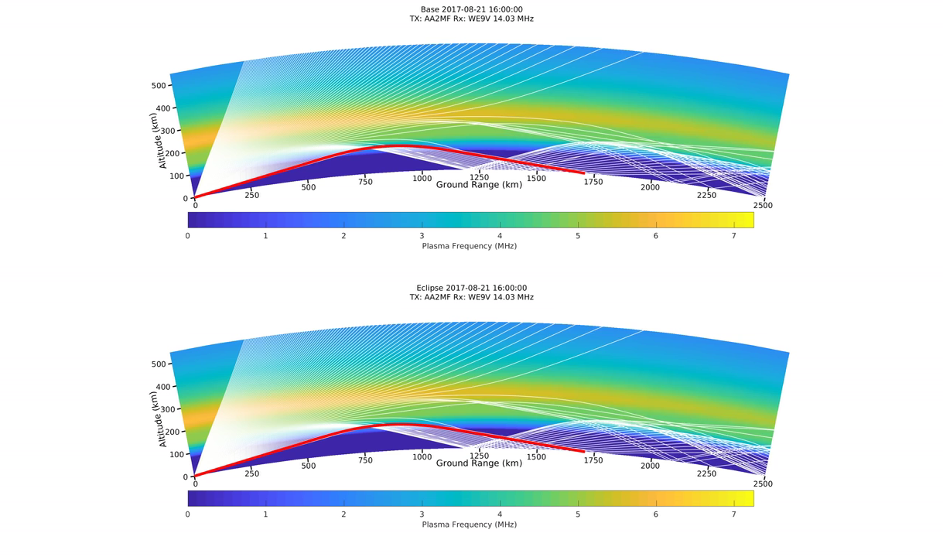
Refraction as a Function of Electron Density
14.03 MHz
Eclipsed SAMI3/PHaRLAP Simulation
21 August 2017 • 1600 – 2200 UT
14.03 MHz • TX: AA2MF (Florida) • RX: WE9V (Wisconsin)

Slide 44
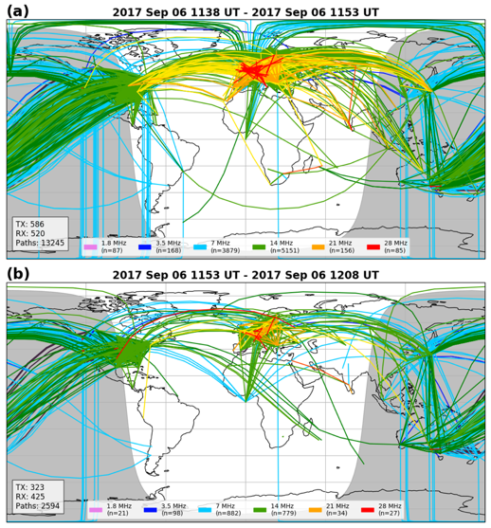
HF Response to Solar Flare
13,245 Paths
 | 28 MHz
 | 21 MHz
 | 14 MHz
 | 7 MHz
 | 3.5 MHz
 | 1.8 MHz
6 Sept 2017
1153 UT
X9.3 Flare
2,594 Paths
[Frissell et al., 2019]

Slide 45
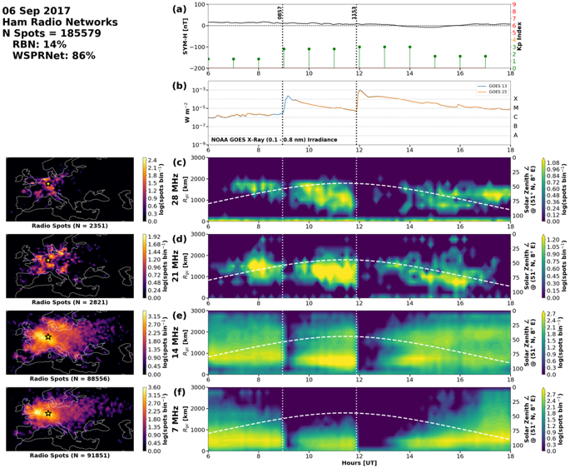
EU Response to Solar Flares
Quiet Kp/Sym-H
GOES Flares
X2.2: 0857 UT
X9.3: 1153 UT
Europe in daylight.
Both flares cause deep blackouts.
28 MHz
21 MHz
14 MHz
7 MHz
[Frissell et al., 2019, doi:10.1029/2018SW002008]
6 UT
18 UT
250 km × 10 min bins

